Slide 1
Francesco

Slide 2


A Controlled Study of NeurOptimal™ Neurofeedback
in Tinnitus Patients
Preliminary Results
Presented by
Francesco Lanza
Dr. Raponi Dr. Messina
Milano Italy Palermo
NeurOptimal™ Conference in Montreal Canada
May 21-22-23 2018

Slide 3
Study and Investigators
“A randomized study of Neuromodulation, using Neurottimo® brain training system, on tinnitus symptoms and associated psychological distress factors in patients diagnosed with tinnitus”.
Investigators are:
Dott. Aldo Messina, Oto Laryngologist and Audiologist
  Head Department of Audiology of the University Hospital "Paolo Giaccone" of Palermo
Dott. Giorgio Raponi, Oto Laryngologist and Oto Neurologist
  Expert in Tinnitus-Vertigo-Deafness Diagnostic and Management
Dott. ssa Michela Maria Di Nardo, Masters Statistician
  Consultant and Analyst, Expert in collection and analysis of clinical data
Dott.ssa Marianna Franco, Psychotherapist of the University Hospital "Paolo Giaccone" of Palermo
Dott.ssa Elisa Tocco, Oto Laryngologist of the University Hospital "Paolo Giaccone" of Palermo.
Zengar Institute has supported our research with loaner equipment.

Slide 4
What is Tinnitus?
Perception of a Sound
in the Absence of Acoustic Stimulation

Slide 5
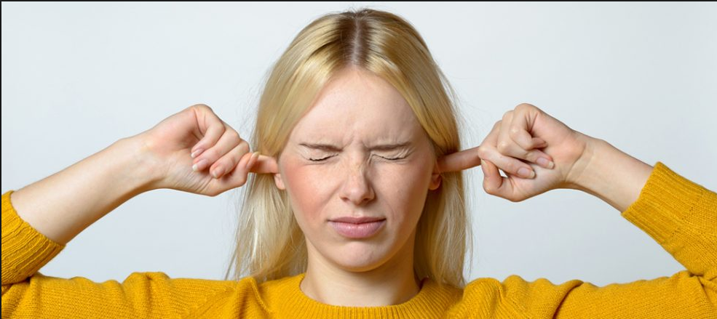
What is Tinnitus?
Recent clinical and laboratory evidence points to initial deafferentation of auditory input (from damage to the cochlear) and subsequent disordered neural plasticity underlying the genesis of tinnitus.
EEGs show “the formation of self-perpetuating feedback loops among several different nerve-cell classes in the auditory cortical region, AND now there is evidence indicating that the brain location generating tinnitus occurs at sites DIFFERENT FROM the initial (auditory) pathology.
Tinnitus can be triggered by other sensory inputs (somatosensory, somatomotor, visual-motor). This spontaneous and constant cortical (gamma-band) hyperactivity generates a “phantom” sound which is profoundly debilitating”.
Neuromodulatory strategies such as rTMS and chronic electrical stimulation have been shown to
alter these processes with beneficial results.

Slide 6
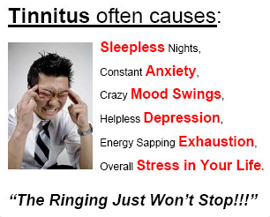

Slide 7
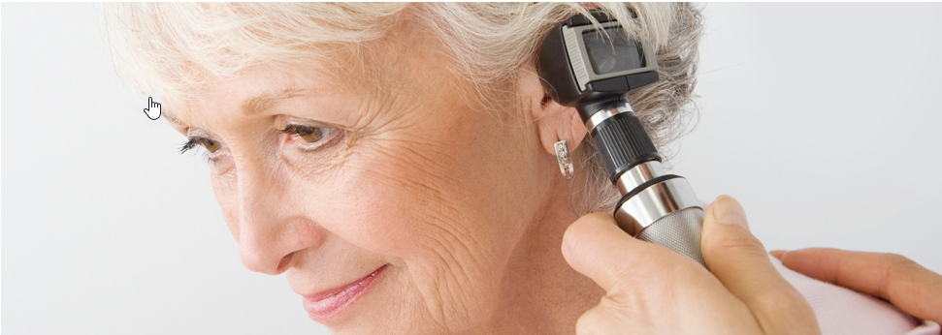
Our Thesis:
Our thesis is that 20 NeurOptimal sessions given over a period of 10 weeks will result in a decrease of clinician-determined audiological tinnitus symptoms and an improvement in the emotional state and tolerance of this disorder.

Slide 8
Research Protocol
We are offering NeurOptimal training to up to 60 recruited patients with a run-in using “sham” training to establish the control value or baseline.
The “sham” training should last for 5 weeks (10 sessions) and the standard training should last for 10 weeks (20 sessions).
We are collecting baseline data:
Depression, anxiety and stress (DASS21 Questionnaire)
Audiometric measurements of acuphenometry (Residual Inhibition)
Tendency to pathological preoccupation (PSWQ Questionnaire)
Sleep quality (PSQI Questionnaire)
Handicap level provoked by tinnitus (THI Questionnaire).
Results are to be compared before and after training to see if there is an effect.

Slide 9
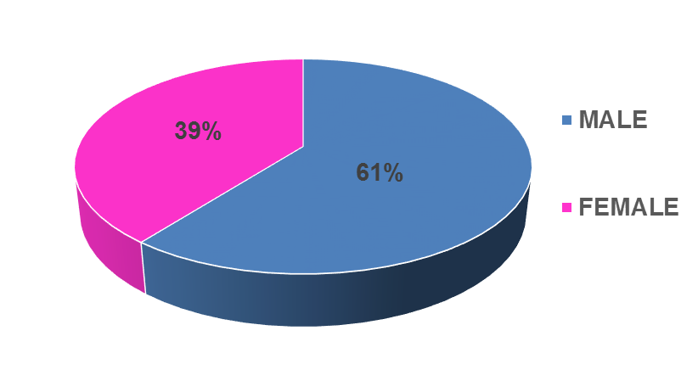
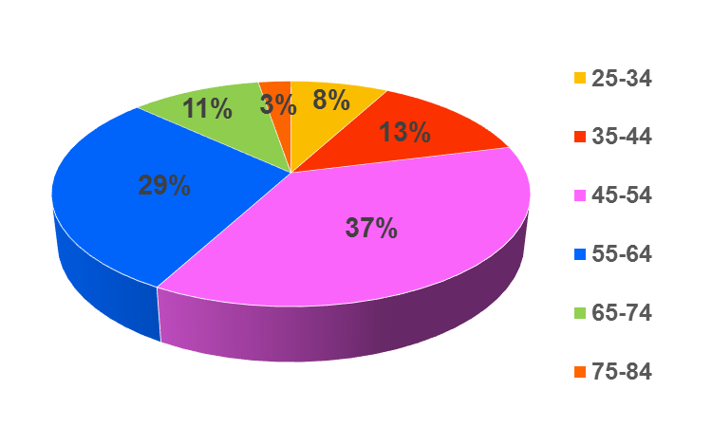
Our Sample: Sex and Age
We have recruited a sample of 38 patients up to 15th April 2018, in the two sites (Milan + Palermo).
About 60% are males
66% are between 45 and 64 years.

Slide 10
Our Sample: Origin of Tinnitus and Age of Onset
Origin of tinnitus can be auditory Deafferentiation or other sensory (Cross Modal)
In most cases, patients have had tinnitus for less than 2 years.
ORIGIN
AGE OF ONSET

Slide 11
Tinnutus at Time T0:
Where, Type and Performance
The highest incidence is for tinnitus Monolateral, Persistent, with sound Whistle.
WHERE
TYPE
PERFORMANCE

Slide 12
Scores at Time T0: Moderate to Severe
Our Tinnitus recruits display, on average baseline scores:
Tinnitus Handicap Inventory: Moderate (THI score = 53)
Pathological Preoccupation Tendency: Moderate (PSWQ score = 49)
Sleep Quality: Poor (PSQI score = 7).
THI
AVE SCORE 7 VS
SEVERITY RATING
PSWQ
PSQI
AVE SCORE 53 VS
SEVERITY RATING
AVE SCORE 49 VS
SEVERITY RATING
0 - 16 POOR
18 - 36 MILD
38 - 56 MODERATE
58 - 76 SEVERE
78 – 100 CATASTROPHIC
0 - 16 VERY LOW
17 - 37 LOW
38 - 59 MODERATE
60 - 80 HIGH
>=5 POOR SLEEP QUALITY

Slide 13
Scores at Time T0: DASS21 Mild to Moderate
Our Tinnitus recruits display, on average DASS baseline scores:
DASS Mild Depression (Score = 6),
DASS Moderate Anxiety (Score = 6) and
DASS Mild Stress (Score = 9).
DASS
Depression
DASS
Stress
DASS
Anxiety
AVE SCORE 6 VS
SEVERITY RATING
0 - 7 NORMAL
8 - 9 MILD
10 - 12 MODERATE
13 - 16 SEVERE
17 + EXTREMELY SEVERE
AVE SCORE 6 VS
SEVERITY RATING
AVE SCORE 6 VS
SEVERITY RATING
0 - 3 NORMAL
4 - 5 MILD
6 - 7 MODERATE
8 - 9 SEVERE
10 + EXTREMELY SEVERE
0 - 4 NORMAL
5 - 6 MILD
7 - 10 MODERATE
11 - 13 SEVERE
14 + EXTREMELY SEVERE

Slide 14
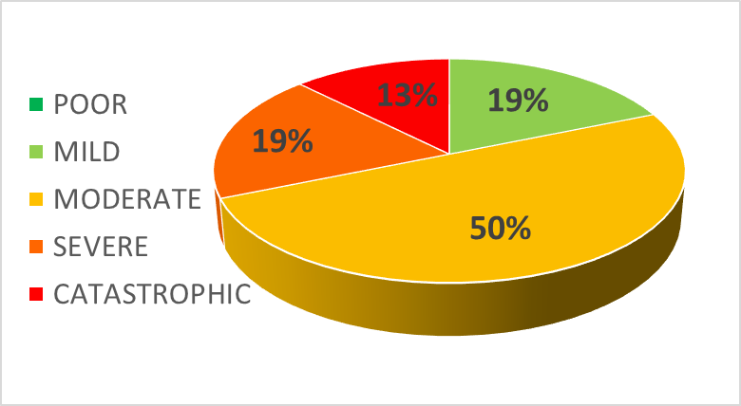
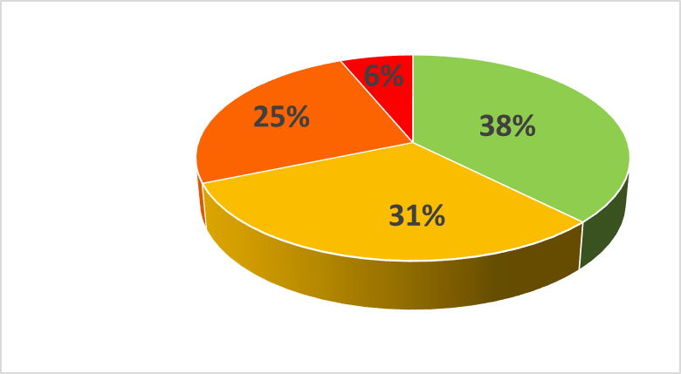
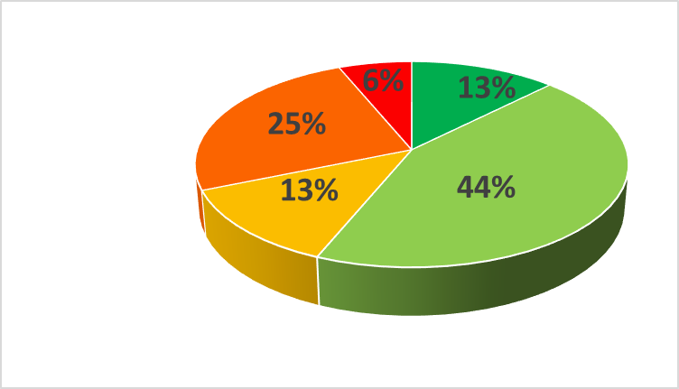
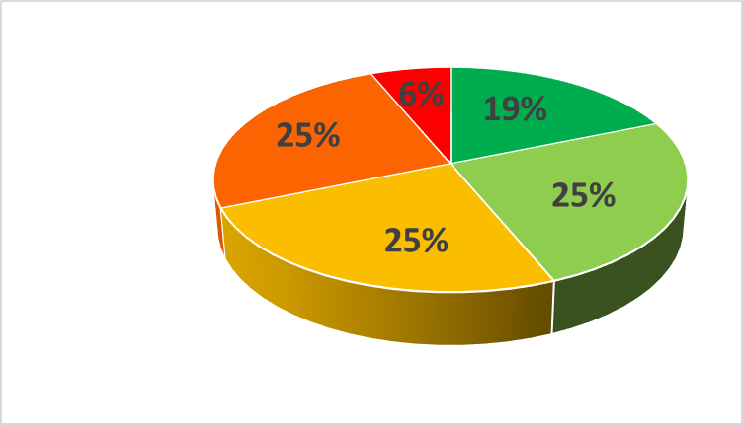
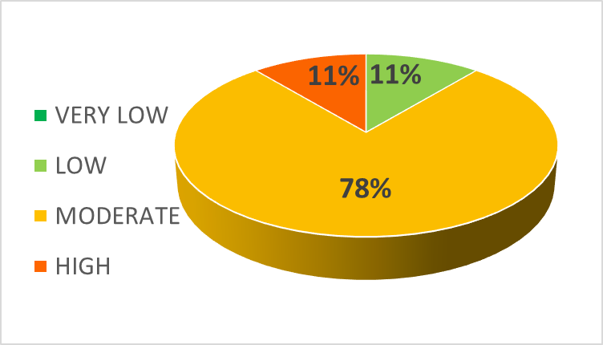
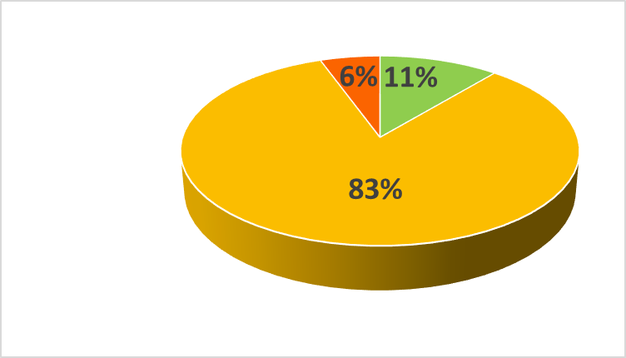


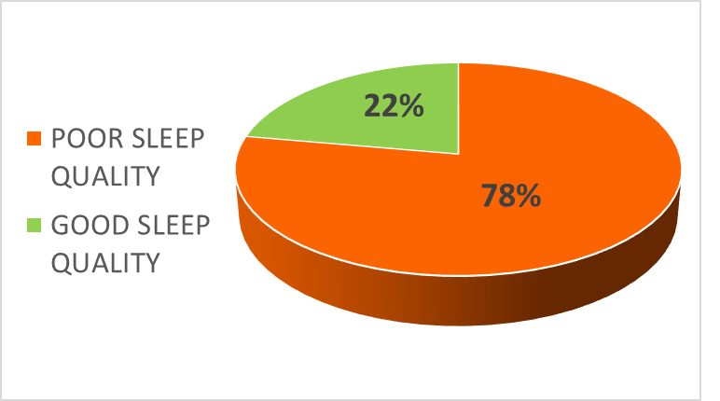
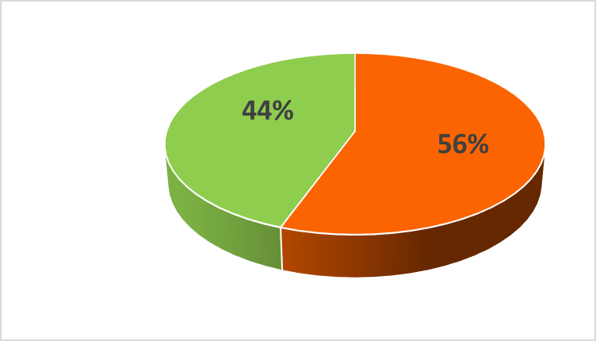
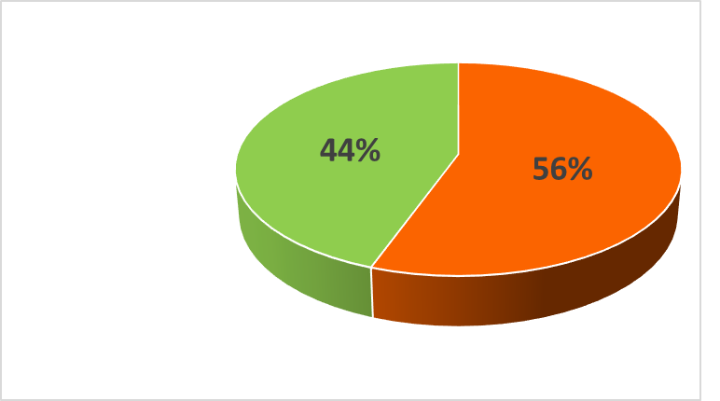
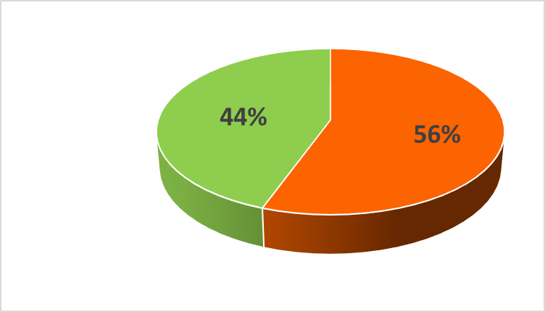
Tinnitus Patient Profile after NeurOptimal Training
T0
before start
with “sham” training
T1
at the end of “sham” training and before standard training
T2
after standard
10 sessions
T3
after standard
20 sessions
THI
NIL
Average score
Handicap moderate Variation % vs T0
53 Moderate
47
-11%
44
-17%
44
-16%
PSWQ
Average score
Variation % vs T0
47
46
-2%
47
0%
47
-1%
PSQI
Average score
Variation % vs T0
7
5
-24%
5
-27%
5
-25%
Note: Patients that concluded sham + standard training and completed all questionnaires up to 15th April (18 cases).

Slide 15
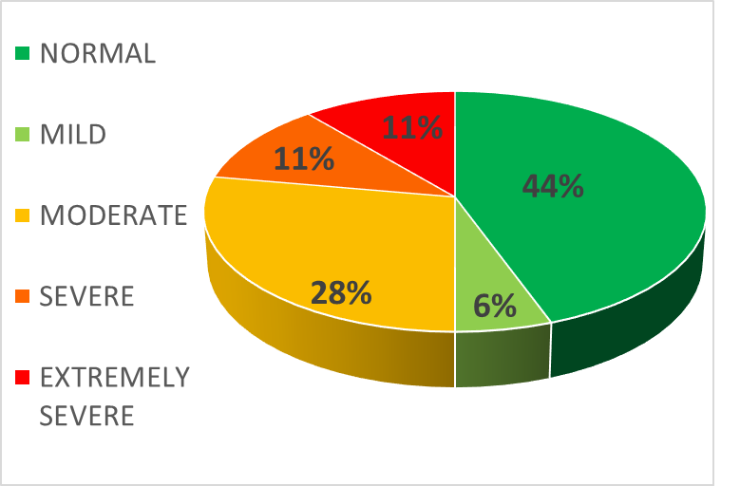
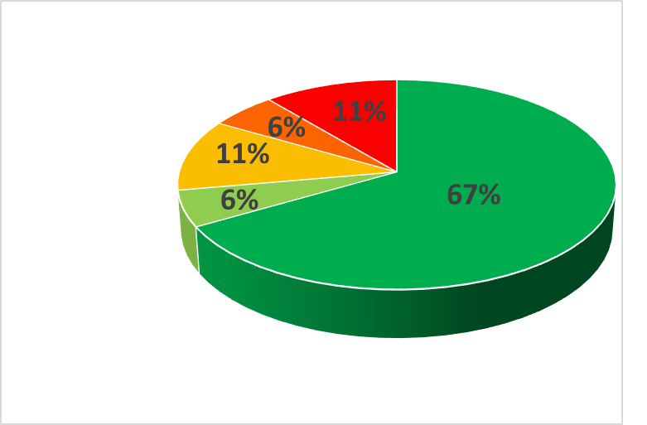
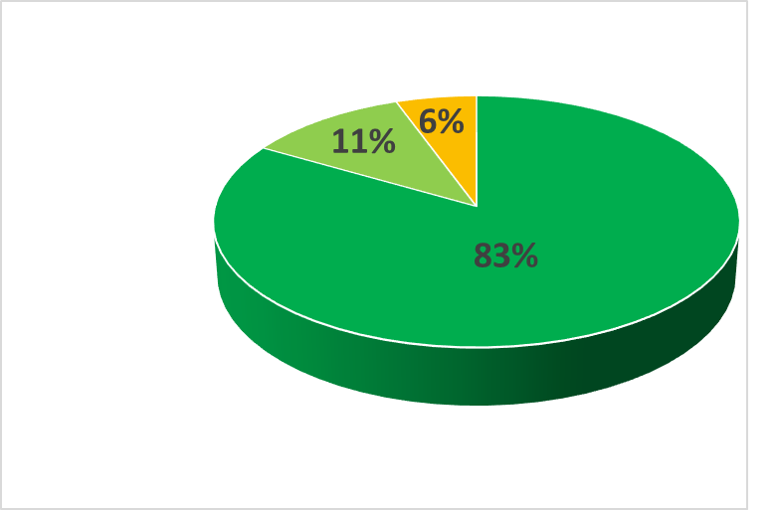
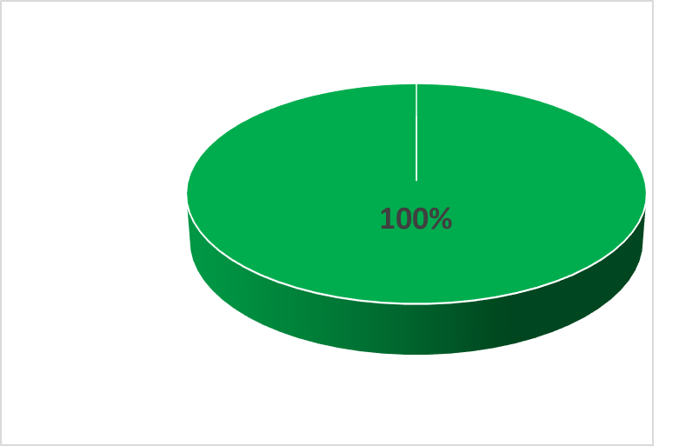
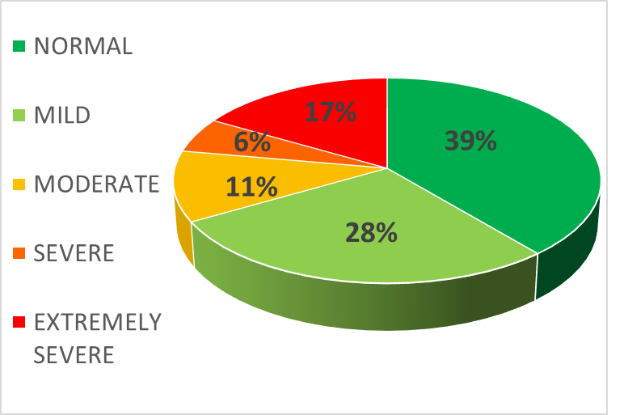
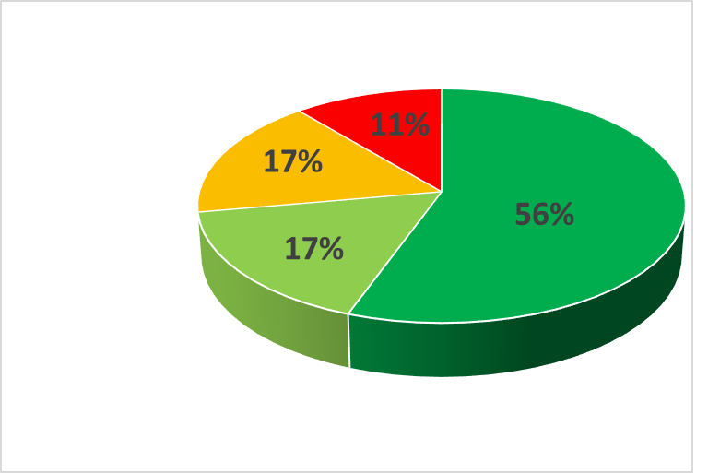
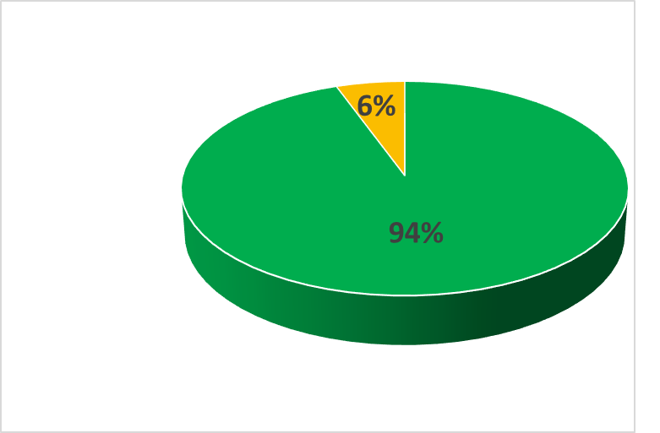

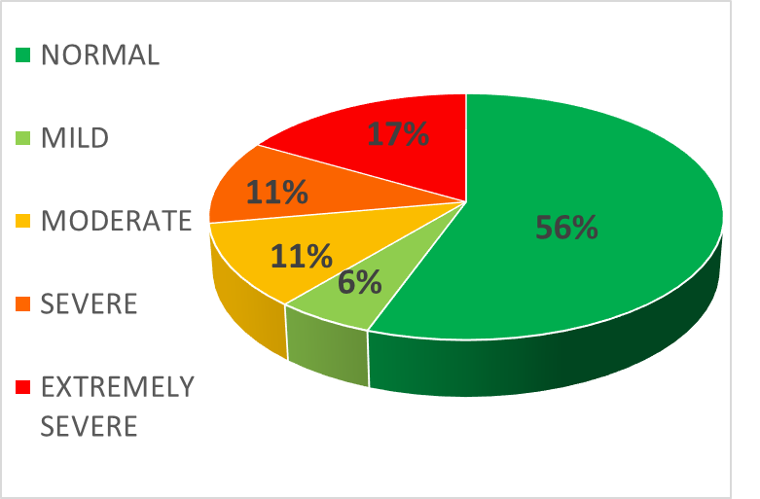
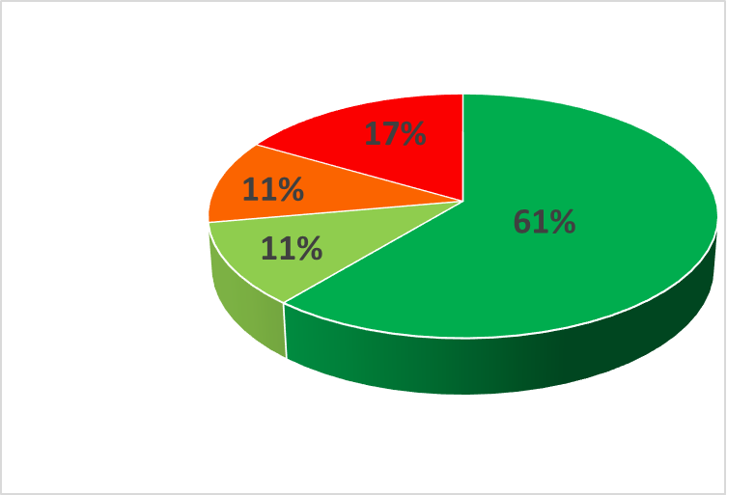
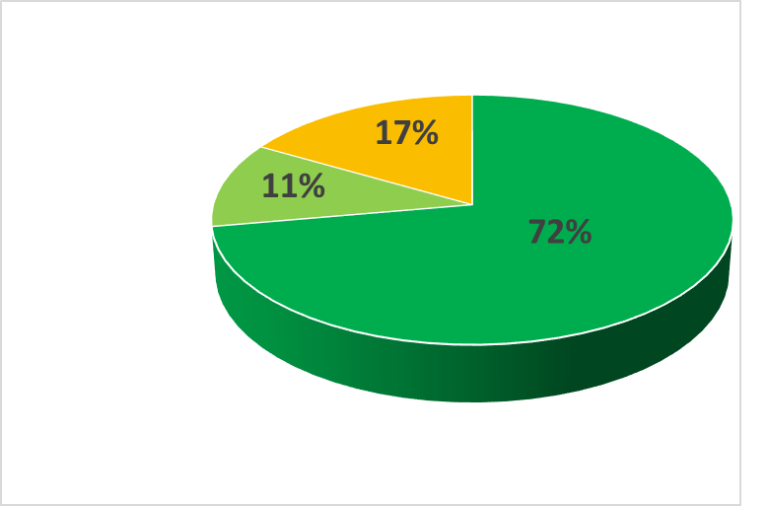
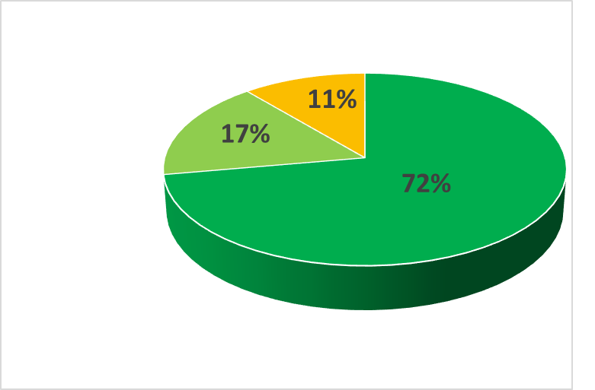
Tinnitus Patient Profile after NeurOptimal Training
T0
before start
with “sham” training
T1
at the end of “sham” training and before standard training
T2
after standard
10 sessions
T3
after standard
20 sessions
DASS
Depression
Average score
Variation % vs T0
7
6
-15%
2
-69%
2
-77%
DASS
Anxiety
Average score
Variation % vs T0
5
4
-19%
1
-73%
1
-78%
DASS
Stress
Average score
Variation % vs T0
10
9
-9%
6
-40%
5
-45%
Note: Patients that concluded sham + standard training and completed all questionnaires up to 15th April (18 cases).

Slide 16
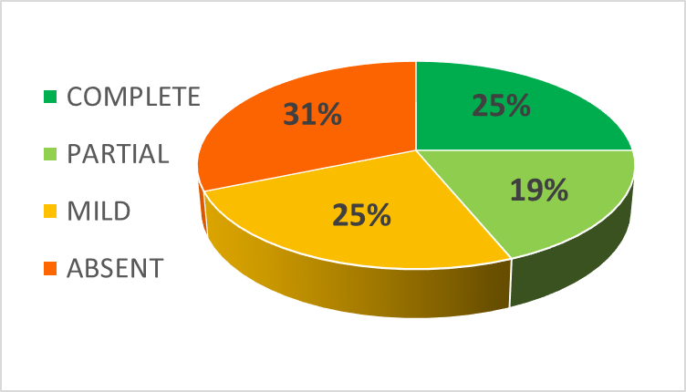
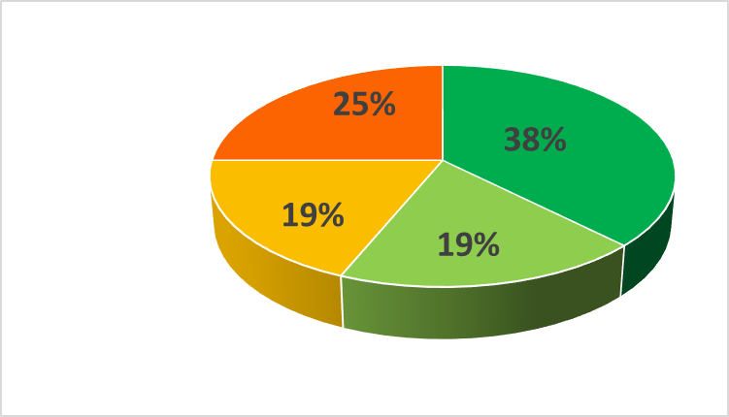
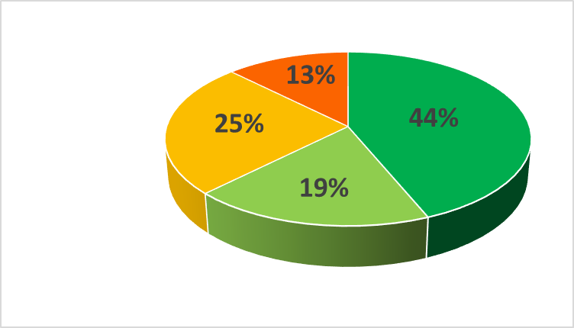
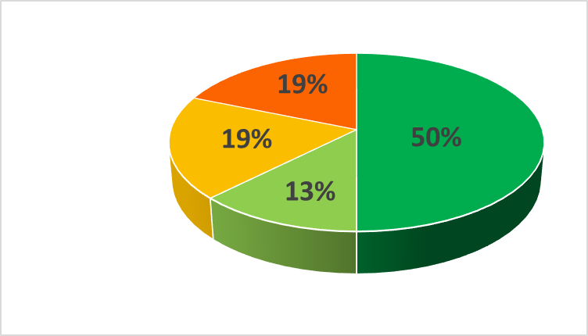
Residual Inhibition Profile after NeurOptimal Training
Residual Inhibition: The Residual Inhibition test evaluates the "residue" of the tinnitus after administering a masking tone for one minute.
T0
before start
with “sham” training
T1
at the end of “sham” training and before standard training
T2
after standard
10 sessions
T3
after standard
20 sessions
INHIBITION
Acuphenometry (Average acufenometry: average of frequencies from 250hz to 8.000hz and average of right ear and left ear in case of bilateral tinnitus).
Variation % vs T0
-12%
-15%
-21%
Note: Patients that concluded sham + standard training and completed all questionnaires up to 15th April (18 cases).

Slide 17
Preliminary Results and Next Steps
Basing on these measurements of the partial sample, the impact of NeurOptimal training seems to be very positive on emotional states, stress and sleep quality.
For tinnitus handicap and pathological preoccupation, slight improvement has been seen in the mild-moderate groups.
In addition, both Acufenometry and Residual Inhibition measurements have improved, permitting this relief modality to be used.
Other positive effects that we have detected are: improvement in concentration and management of emotions, important reduction or disappearance of headache, sense of serenity and self-control.

Slide 18
Preliminary Results and Next Steps
We agree to recruit a minimum of 60 patients, to be able to confirm and validate these results.
With a larger sample, we’ll analyze acuphenometry/ audiometric measurements and questionnaires score to evaluate if there are statistically significant differences between T0 and T1 and T2 and T3.
It may also be checked (according to sample size) if there are significant differences in the effect of training between cluster/target identified by sex, by age, by tinnitus type, by audiometric type, by THI type, by PSWQ type, by PSQI type and by DASS type.

Slide 19
Thank You
For Your Attention

